Slide 1
Asymptotic inference in OLS
蒋智超
2025年 秋

Slide 2

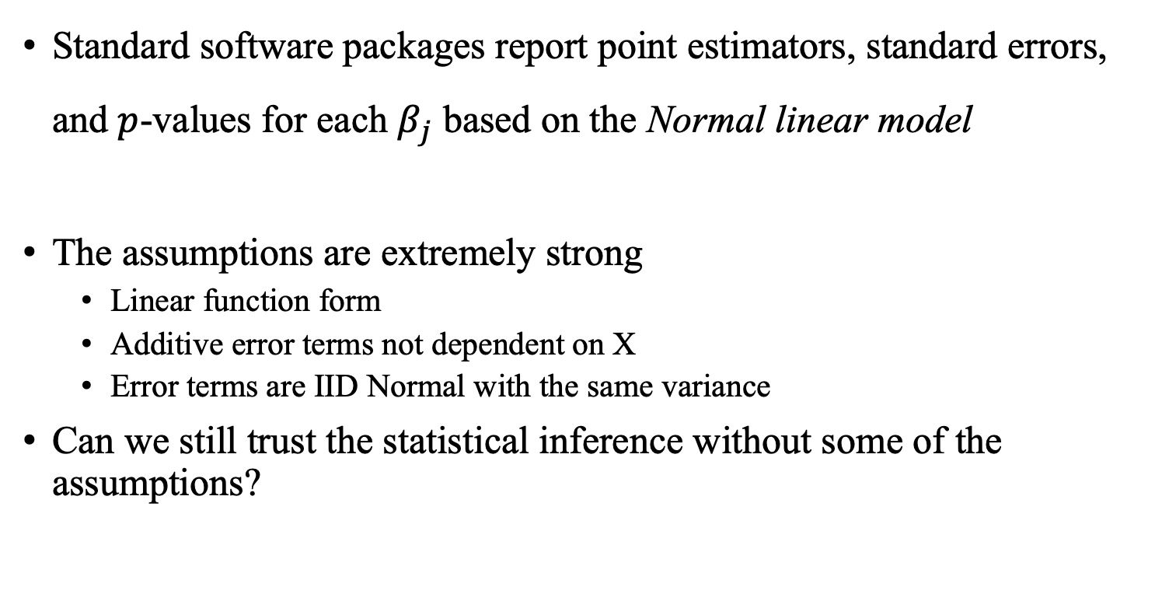
Motivation
Standard software packages report point estimators, standard errors, and $p$-values for each $β_{j}$ based on the Normal linear model
The assumptions are extremely strong
Linear function form
Additive error terms not dependent on X
Error terms are IID Normal with the same variance
Can we still trust the statistical inference without some of the assumptions?

Slide 3

多选题
1分
Which of the following scenarios make the assumption of Normally distributed errors plausible?
A
You regress college admission success (admitted = 1, not admitted = 0) on test scores
B
You regress annual household income on education and age
C
You regress adult height on nutrition indicators
D
You regress customer satisfaction ratings (1–5 stars) on service time and price
提交
Notes:
Normality test

Slide 4
多选题
1分
In which of the following scenarios is the assumption of homoskedastic errors plausible?
A
The outcome is annual income, where education and experience are included as covariates
B
The outcome is a binary indicator of success or failure
C
The outcome is test scores from a standardized exam
D
The outcome is the number of doctor visits
提交
Notes:
Breusch-Pagan test / White test

Slide 5
Simulation
Four scenarios (replicate 5000 times)
Ideal Normal linear model
Non-Normal error terms
Normal error terms with variances depending on X
Non-Normal error terms with variances depending on X
For each replication, we obtain
Estimated coefficient for each replication (se0)
Standard error based on the Normal linear model (se1)
hccm standard error (se2)

Slide 6
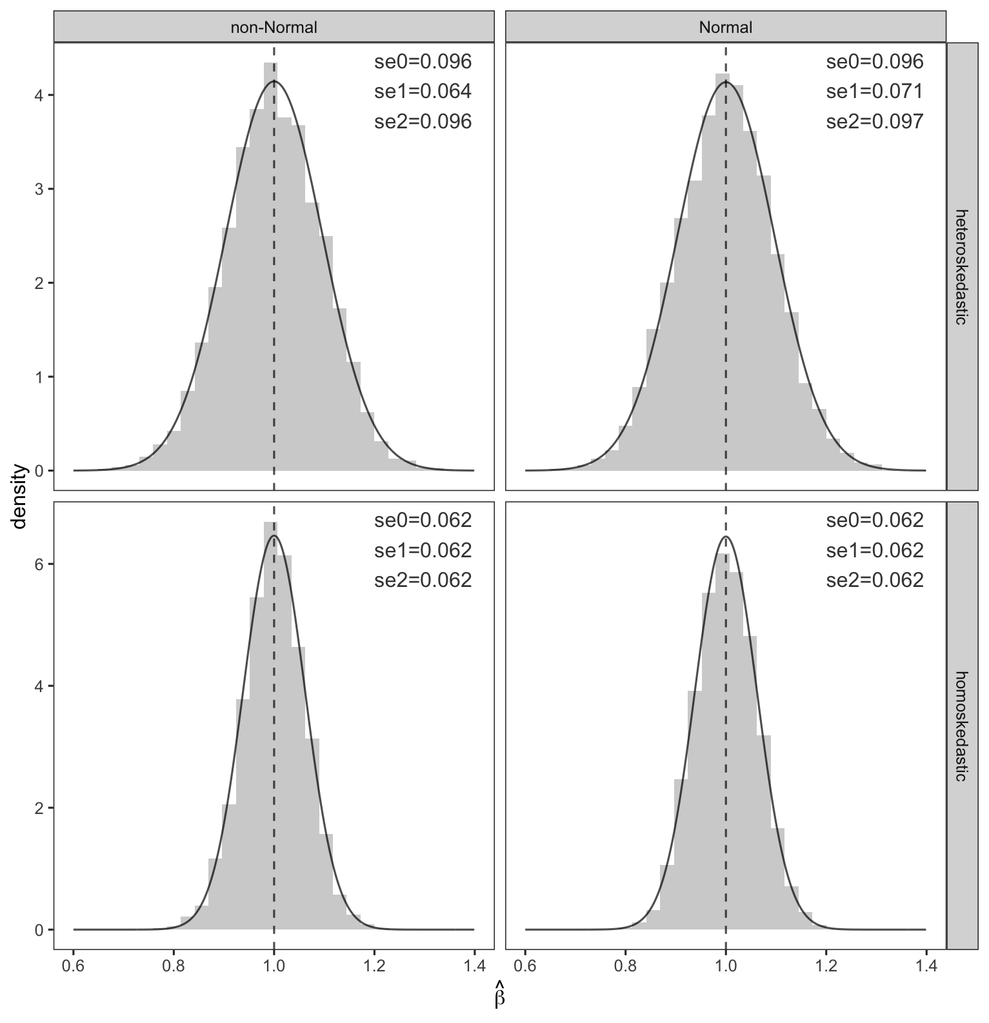
Simulation results
Notes:
Repeated sampling， normal distribution is not required， homoskedasticity is crucial

Slide 7
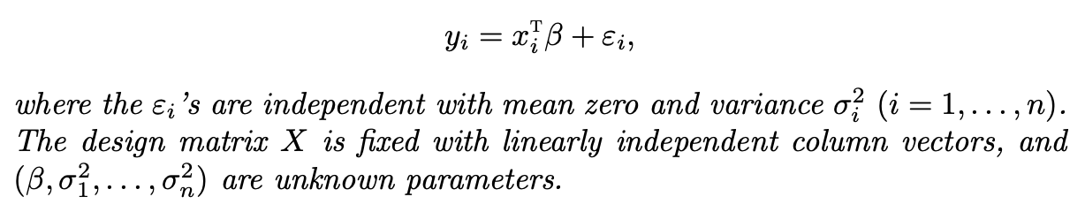
Heteroskedastic linear model
Error terms have different variances, which can depend on $x_{i}$
No Normal distribution assumption on the error terms, so no finite sample exact distribution of OLS estimator
Need to use asymptotic analysis, assuming $n$ is large enough so that CLT holds
Notes:
Compare with Gauss Markov model

Slide 8
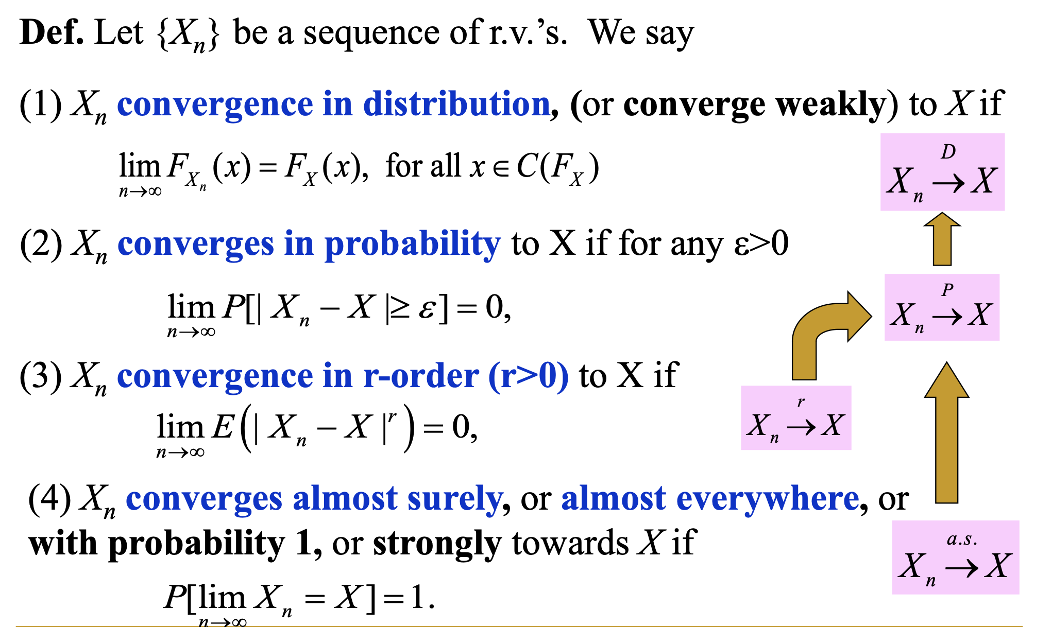
Basic asymptotics

Slide 9
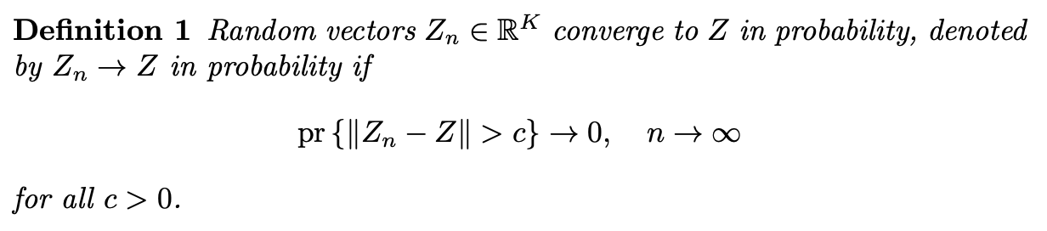
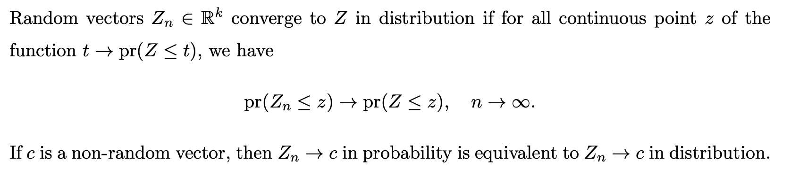
Basic asymptotics

Slide 10
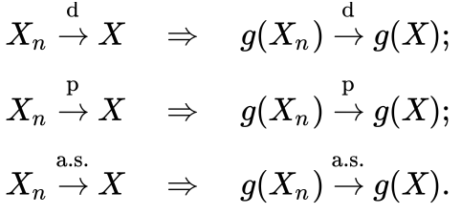
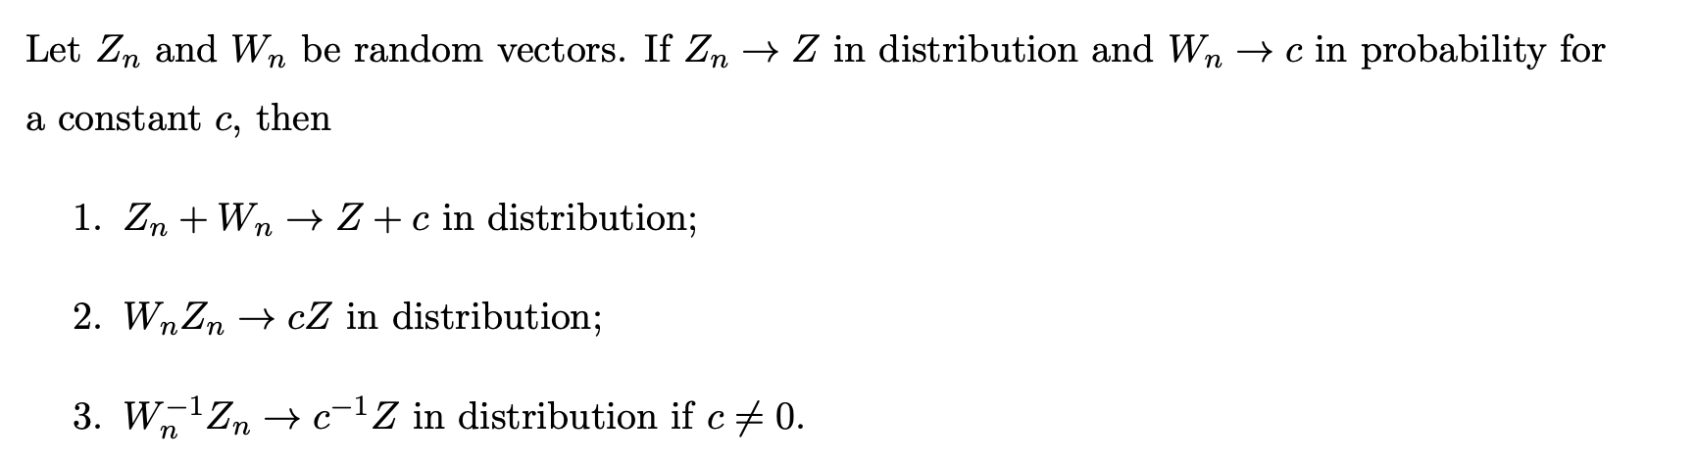
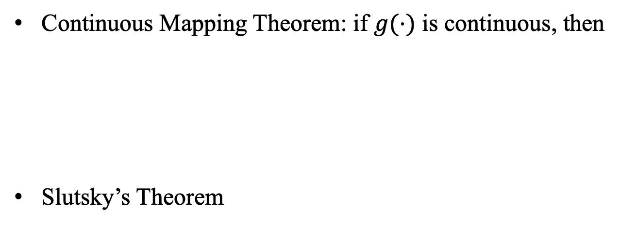
Properties
Continuous Mapping Theorem: if $g(⋅)$ is continuous, then
Slutsky’s Theorem

Slide 11
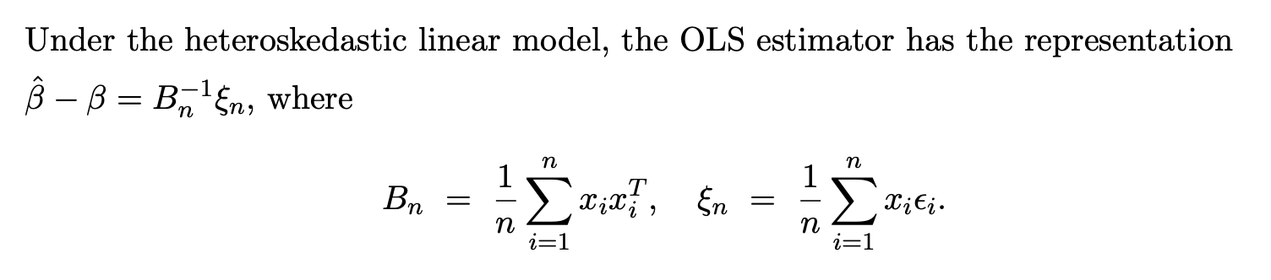
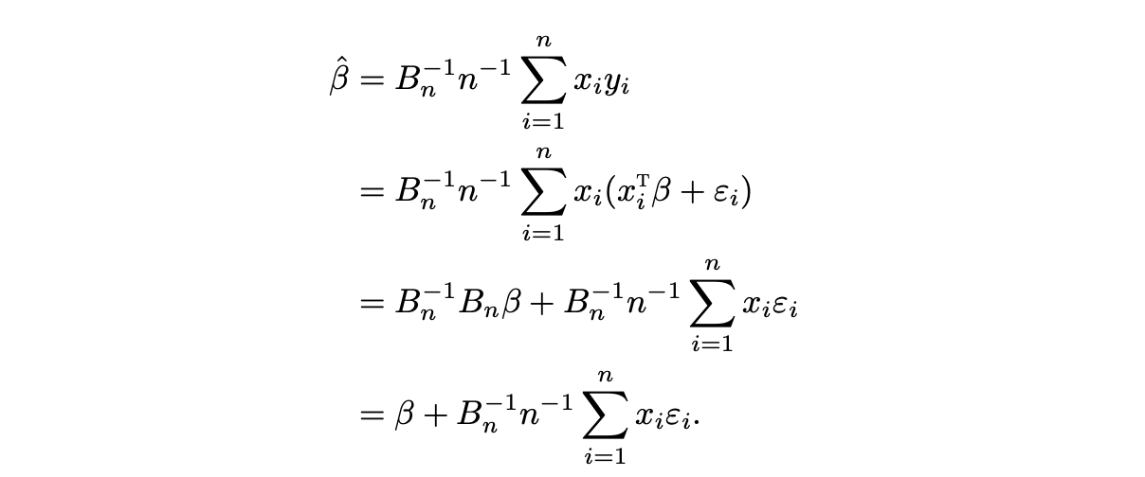
Consistency of OLS estimator
Proof:

Slide 12
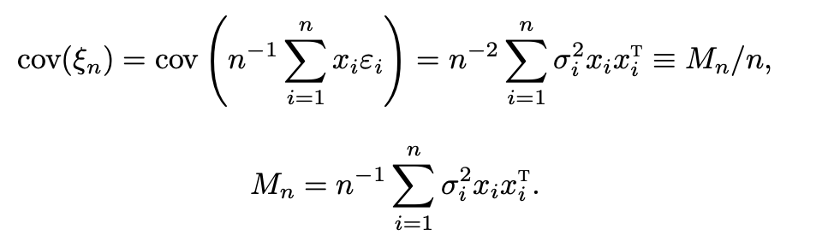


Consistency of OLS estimator
The OLS estimator is unbiased
Covariance of the OLS estimator
Sandwich form: $B_{n}$ for “bread” and $M_{n}$ “meat”

Slide 13
Consistency of OLS estimator
Assumption 1
Consistency of OLS estimator
Proof:

Slide 14
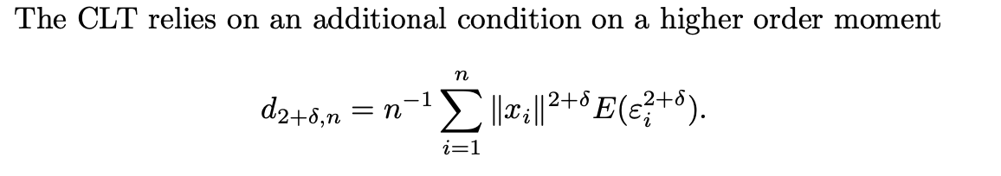
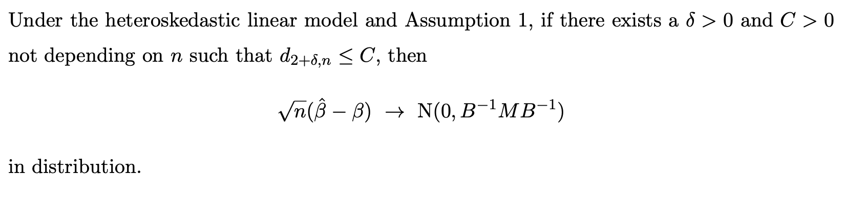
Asymptotic Normality of OLS estimator
Proof: use Lindberg-Feller CLT

Slide 15
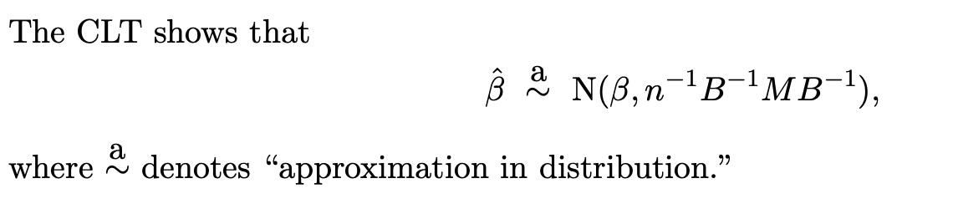
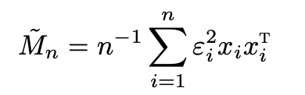
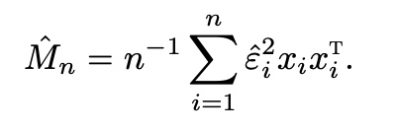

Sandwich variance estimator
Replace $σ_{i}^{2}$ with $ε_{i}^{2}$
Replace $ε_{i}^{2}$ with ${\hat{ε}}_{i}^{2}$

Slide 16
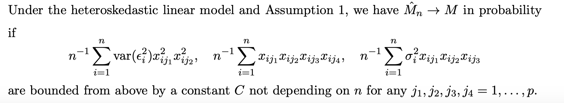
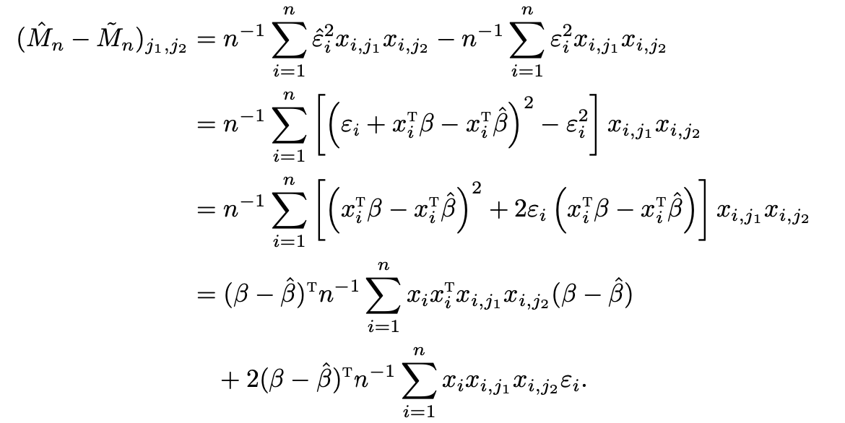
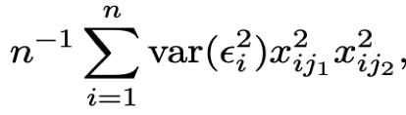

Sandwich variance estimator
Proof:
${\hat{M}}_{n}−M={(\hat{M}}_{n}−{\tilde{M}}_{n})+{(\tilde{M}}_{n}−M$)
Convergence of the second term follows from
Markov’s inequality and the convergence of

Slide 17
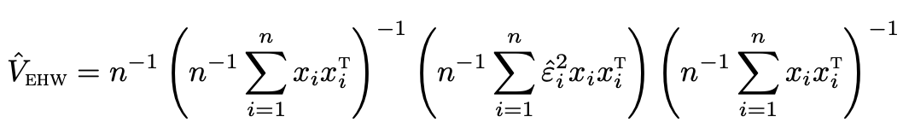


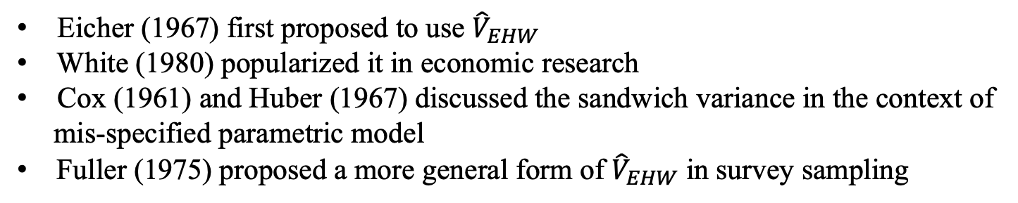
Sandwich variance estimator
Eicker-Huber-White (EHW) heteroskedasticity robust covariance estimator
Eicher (1967) first proposed to use ${\hat{V}}_{EHW}$
White (1980) popularized it in economic research
Cox (1961) and Huber (1967) discussed the sandwich variance in the context of
mis-specified parametric model
Fuller (1975) proposed a more general form of ${\hat{V}}_{EHW}$ in survey sampling
Notes:
The square root of the diagonal terms of Vehw , denoted by sˆeehw,j (j = 1, . . . , p), are called the heteroskedasticity-consistent standard errors, heteroskedasticity-robust stan- dard errors, White standard errors, Huber–White standard errors, or Eicker– Huber–White standard errors

Slide 18
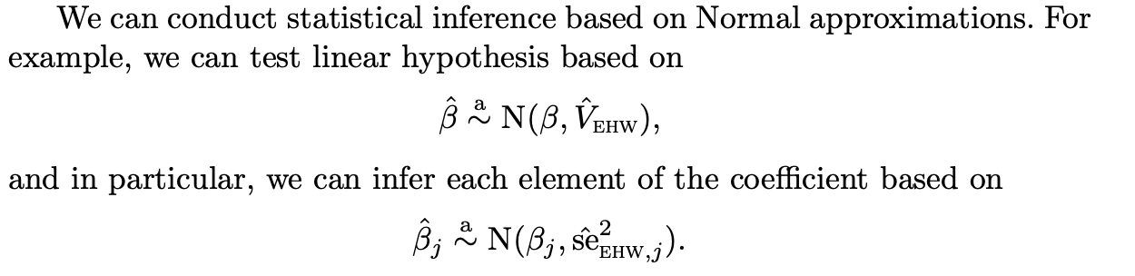
Asymptotic inference of OLS estimator
Inference under Normal linear model: finite sample exact distribution
Inference under heteroskedastic linear model: large sample Normal approximation

Slide 19
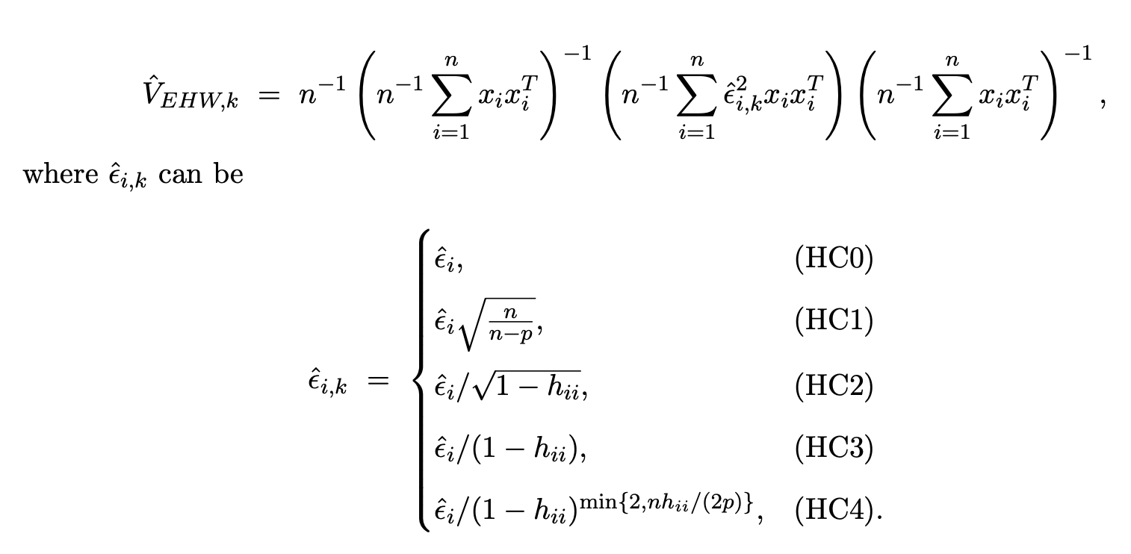
Other “HC” standard errors
Modification of ${\hat{V}}_{EHW}$ aiming for better finite sample properties
Notes:
The HC1 correction is similar to the degrees of freedom correction in the OLS covariance estimator. The HC2 correction was motivated by the unbiasedness of covariance when the error terms have the same variance. The HC3 correction was motivated by a method called jackknife

Slide 20
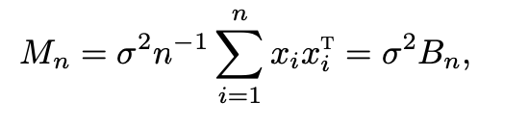
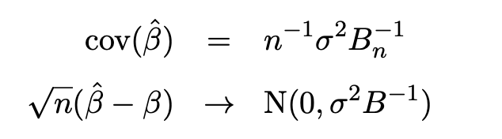
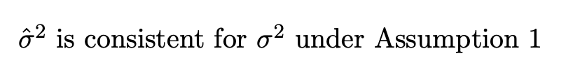
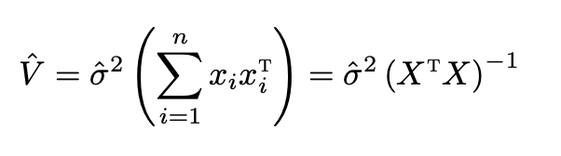
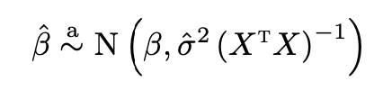

Special case
Homoskedasticity: $σ_{i}^{2}$ = $σ^{2}$
-1
Notes:
For statistical inference, what is the difference between the asymptotic inference and the inference under the Normal linear model

Slide 21
投票(匿名)
最多可选1项
Can we use for the homoscedastic case?
A
Yes
B
No
提交

Slide 22

Revisit the Z test
$X_{1},…,X_{n}$ are i.i.d. with mean $μ$ and variance $σ^{2}$
Linear model: $X_{i}=μ+ε_{i}$, $E\left(ε_{i}\right)=0, var\left(ε_{i}\right)=σ^{2}$
OLS estimate: $\hat{μ}=\overline{X}, {\hat{V}}_{EHW}=\frac{1}{n−1}∑{\left(X_{i}−\overline{X}\right)}^{2}$
Inference on $μ$: $\frac{\left(\overline{X}−μ\right)}{\sqrt{{\hat{V}}_{EHW}}}→N(0,1)$
Binary $X_{1},…,X_{n}$ are i.i.d. with mean $p$
Linear model: $X_{i}=p+ε_{i}$,
OLS estimate: $\hat{p}=\overline{X}, {\hat{V}}_{EHW}=\frac{\hat{p}(1−\hat{p})}{n}$
Inference on $p$: $\frac{\left(\overline{X}−p\right)}{\sqrt{{\hat{V}}_{EHW}}}→N(0,1)$

Slide 23

Revisit the two sample test
$X_{1},…,X_{n}$ are i.i.d. with mean $μ_{1}$ and variance $σ_{1}^{2}$, $Y_{1},…,Y_{m}$ are i.i.d. with mean $μ_{2}$ and variance $σ_{2}^{2}$
Heteroskedastic linear model: $X_{i}=μ_{1}+ε_{i}$, $Y_{j}=μ_{2}+ε_{j}, var\left(ε_{i}\right)=σ_{1}^{2}$ for $i=1,…,n,$ $var\left(ε_{i}\right)=σ_{2}^{2}$ for $i=n+1,…,n+m$
OLS estimate: ${\hat{μ}}_{1}=\overline{X},{\hat{μ}}_{2}=\overline{Y},{\hat{V}}_{EHW}=diag(\frac{∑{\left(X_{i}−\overline{X}\right)}^{2}}{n^{2}},\frac{∑{\left(Y_{j}−\overline{Y}\right)}^{2}}{m^{2}})$
Inference on $μ_{1}−μ_{2}$:

Slide 24
投票(匿名)
最多可选1项
The asymptotic result in two sample Z test requires that
A
Both $m$ and $n$ go to infinity
B
Only $m+n$ goes to infinity
提交

Slide 25

One-way ANOVA with heteroskedasticity
$X_{1j},…,X_{n_{j}j}$ for $j=1,…,b$ are i.i.d. with mean $μ_{j}$ and variance $σ_{j}^{2}$
Normal linear model: $X_{ij}=μ_{j}+ε_{ij}$
OLS estimate: ${\hat{μ}}_{j}={\overline{X}}_{⋅j}, { \hat{σ}}^{2}=SSW/(n−b)$
One-way ANOVA: $H_{0}:μ_{1}=⋯=μ_{b}$
Rewrite the null hypothesis: $C{\left(μ_{1},…,μ_{b}\right)}^{T}=0$
${\hat{V}}_{EHW}=$

Slide 26
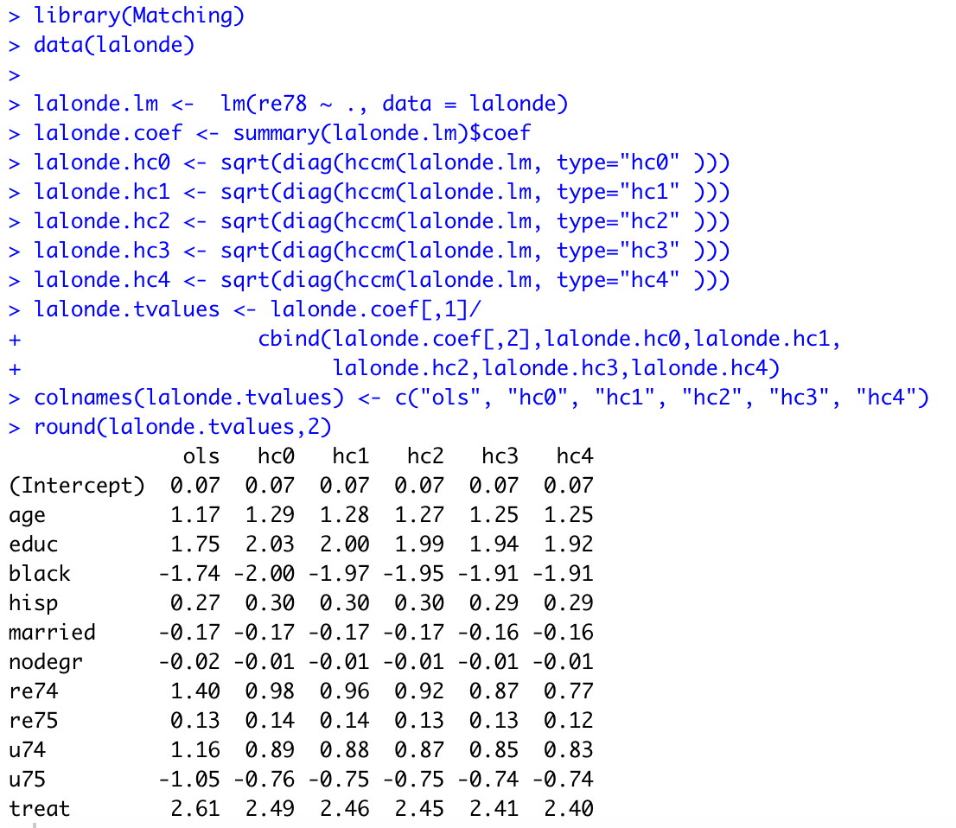
Example: Lalonde data

Slide 27
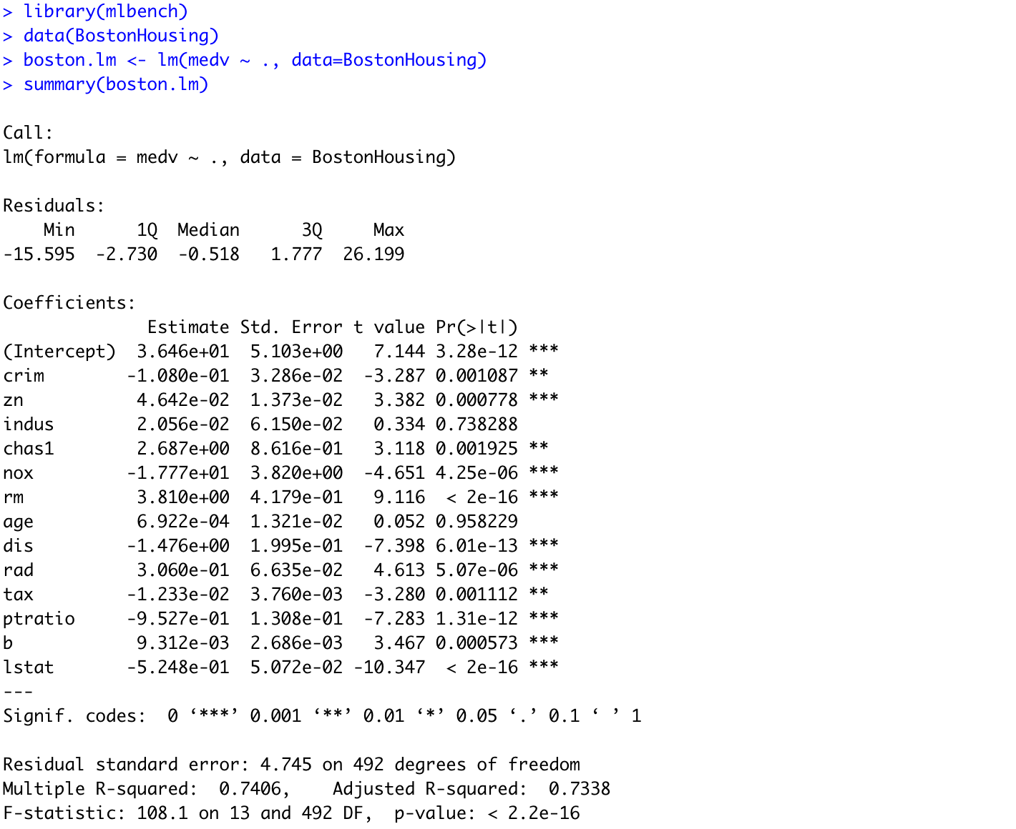
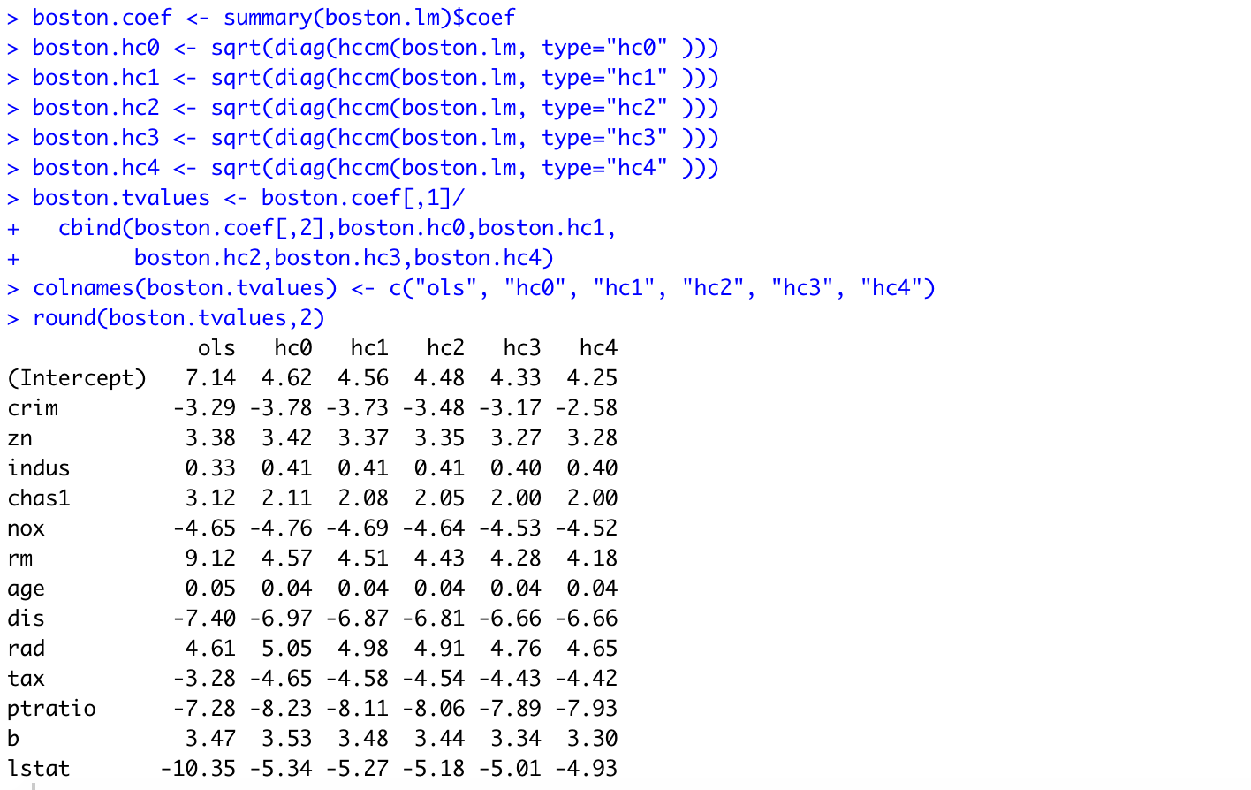
Example: Boston housing data

Slide 28
Final remarks
The asymptotic analysis with EHW standard errors hold under weak parametric assumptions on the error terms.
Limitations
Results based on limiting theorems
Can be severely biased and have large variability in finite samples
Under the heteroskedastic linear model, the Gauss-Markov theorem does not hold, so the OLS can be inefficient
Prediction interval is impossible for a future observation

